Slide 1
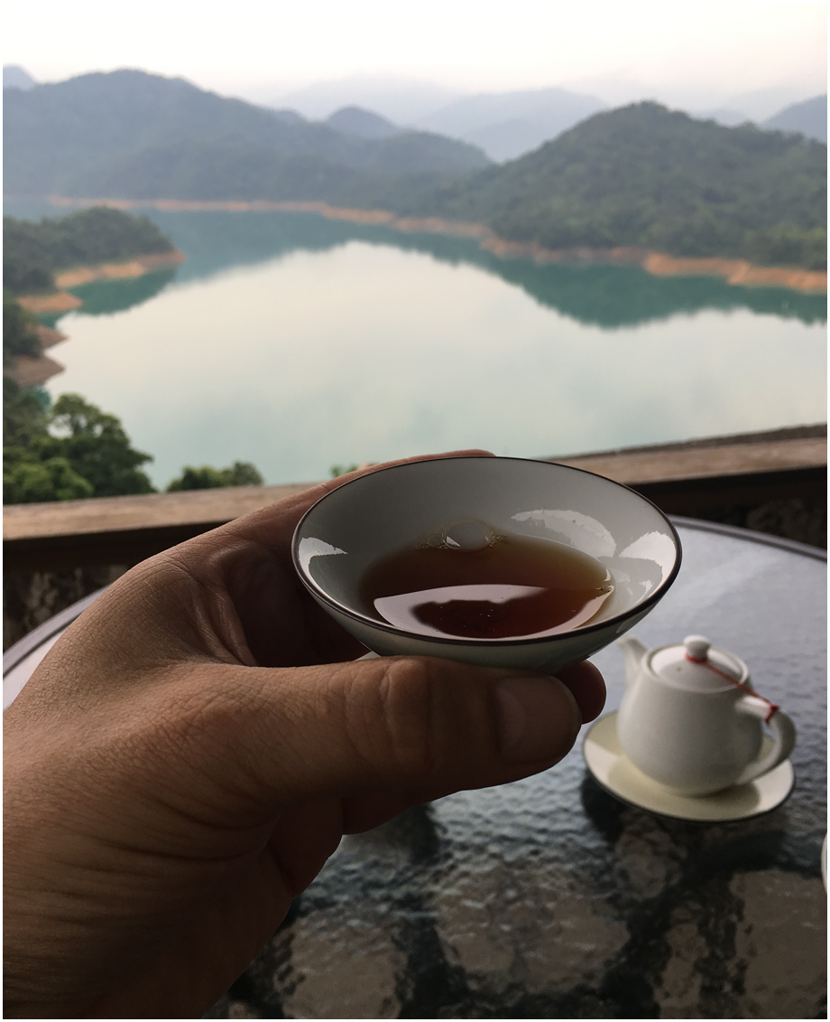
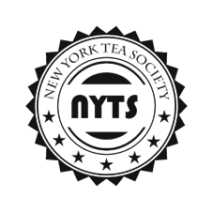
Taiwanese Oolongs
Presented by:
New York Tea Society

Slide 2
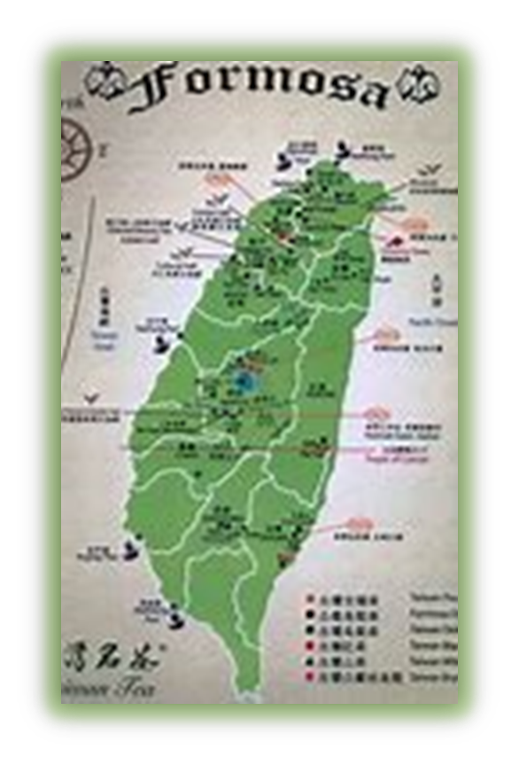
TAIWANESE TEA HISTORY
Taiwan has an indigenous tea, presently known as Camellia Formosensis
In the late 18th century, Ke Chao brought tea trees from Fujian to Taiwan
He planted them in Jieyukeng, modern-day Ruifang District, New Taipei City.
However, transaction records have been discovered which indicate that tea business in Muzha area started as early as late 18th century.
The earliest tea exported from Taiwan was in the latter half of the 1800’s during the Qing dynasty
Oolong tea, mostly baozhong was the most populat Taiwanese tea export
In 1855, Lin Fengchi brought the Qingxin oolong plants from the Wuyi Mountains of Fujian to Taiwan and planted them in Dongding Village, Lugu Township, Nantou County.
This is said to be the origin of Dong Ding tea.
After the Treaty of Tientsin was ratified in 1860 and the port of Tamsui was opened for trade, Scottish entrepreneur John Dodd began working with tea merchants and farmers to promote Taiwanese tea, slowly developing it as a major export item.
In 1867, Dodd started a tea company in Wanhua, Taipei
He began exporting Taiwanese oolong tea to the world under the name "Formosa Oolong".
Aware of British plans to develop a tea industry in India, he successfully sought profit in developing an alternative tea product on the island
In 1895, Taiwan became a Japanese colony
The Japanese shifted from oolong to black tea production to compete with the British.
They planted Camellia Assamica in the Sun Moon Lake area
The Tea Research and Extension Station was created by the Japanese in 1903
They improved existing cultivars and developed new ones.
To this day, the institution has developed 22 or more new cultivars.
In 1945, the Japanese left Taiwan leaving black tea production to decline.
Today, a small black tea industry remains, although Taiwanese oolongs are much more renown,
In the 1980s, TRES and the Taiwanese government began encouraging local farmers to experiment with growing tea at higher altitudes.
The oolong tea grown at higher altitudes was found to have an incredible flavor
The lower amounts of oxygen in the air caused the plants to grow slower, concentrating flavor components into the tea leaves
Alishan was the first testing ground, making it the most popular high mountain region in Taiwan..
Teas grown at 1000 meters of higher are considered high mountain
Alishan’s teas are grown around 1000-2000 meters.
Dayuling teas are grown as high as 2600 meters.
High mountain tea farming is bad for the environment
It leads to deforestation and soil erosion.
The government is dismantling some of its high mountain tea farms.
Demand for Taiwanese teas far exceeds production, which has led to “counterfeit” Taiwanese teas, being produced in Southeast Asia.
Taiwan produces a limited amount of tea and almost none of it is exported.
Taiwan must import a large amount of tea to meet local demand, particularly for bottled and iced tea beverages.

Slide 3
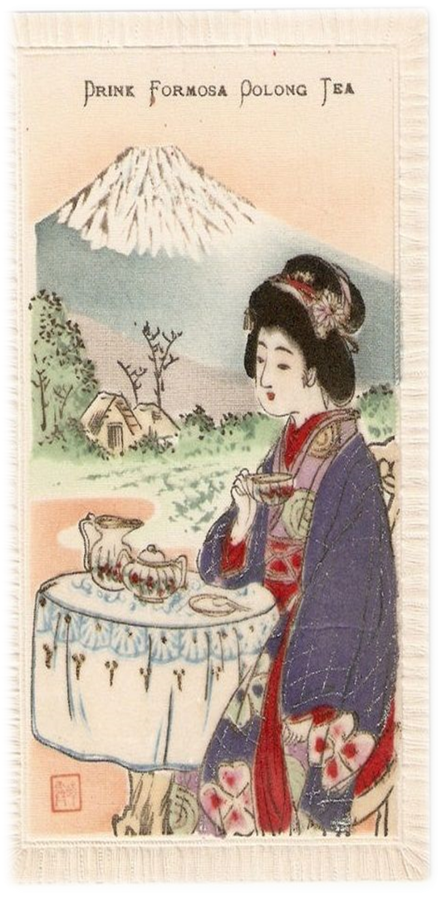
Chinese Influence
z
Fujian Chinese traders migrated to Taiwan in the 1800’s starting Taiwan’s commercial tea cultivation and export.
Seedlings from the Wuyi District in China were planted near Jiufeng in northern Taiwan
In early 1800's, the teas grown in Taiwan were sent back to China for processing
. This tea was produced for local consumption and for trade with China.
At the time, China had severe restrictions on foreign trade, which also applied to Taiwan.
The Opium War of 1839 - 42, resulted in treaties forcing China to open five ports to foreign trade.
In 1860, Taiwan's Danshui and Kaoshiung ports were also opened, paving the way for new industries to be established in Taiwan.
A British merchant named John Dodd convinced tea makers from Fujian to move to Taiwan and export the finished teas directly out Taiwan.
Realizing the commercial potential in Taiwan tea, John Dodd provided loans to the farmers in north Taiwan to increase their production of tea.
John Dodd marketed teas cultivated and processed in Taiwan under the name Formosa tea and started to export to England and New York in 1869.
Formosan oolong tea was well-received in the USA, increasing the prestige of Taiwan tea and encouraging other exporters to set up shop.
Tea exports grew from 180,000 pounds in 1865 to more than 16 million pounds in 1885.
By the end of the 19th century, tea was Taiwan's primary export.

Slide 4
z
Japanese Influence
In 1894 the First Sino-Japanese War began between Qing Dynasty of China and Meiji of Japan for control over Korea.
During the war, Japan occupied the Penghu Islands off the west coast of Taiwan, cutting off Taiwan from the Chinese mainland, forcing China to cede control of Taiwan to Japan.
In 1895, Qing Dynasty lost Taiwan to the Japanese
The Japanese occupation lasted from 1895-1945.
Taiwan forces attempted resistance by declaring Taiwan an independent republic., however, within 5 months the Japanese had defeated the Republican forces and gained control of Taiwan.
The Japanese continued exporting oolong to the English and Americans, and increased the production of black tea, for exportation to Russia and Turkey.
. The Japanese introduced modernized infrastructure
The Japanese built railroads and infrastructure to enable black tea production for export, scaling up the tea productivity on the island.
machinery for tea production
new methods of farming and cultivation.
In 1903, the Japanese established the TRES (Tea Research Extension Station)
The institute aimed to explore agricultural methods to maximize tea yields, and to develop new tea varietals specifically suited to Taiwan.
Several of these varietals remain popular to this day.
During the Japanese era, Taiwan tea was promoted world-wide at international fairs.
Primary markets for Taiwan tea exports included Japan, the United States, Britain, Hong Kong, and Russia.

Slide 5
z
TRES - Tea Research Extension Station
established in 1903 by the Japanese
a government institute committed to the research, development, and production of the Taiwanese tea industry.
developed new tea cultivars
held local tea competitions
improved techniques and methods for tea making.
still the most influential organization supporting the Taiwanese tea industry to this day.
Presently, TRES brings focus on tea consumption safety, organic farming and certification to elevate the quality and international status of Taiwanese teas.

Slide 6
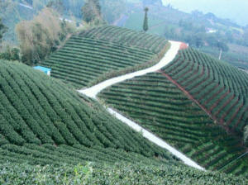
Taiwanese
Tea Cultivars
Qing Xin (Green Heart)
Originates in Taiwan.
At one time Qing Xin was used in 40% of Taiwan’s tea plantations.
It is a small dense tea bush and the leaves have pronounced veins.
It is used for Oolong tea and Bao Zhong tea.
It is more prone to disease than other Taiwan varietals.
Qing Xin Da You
Originates in Taiwan.
Tea farmers favor Da You because of its greater leaf production and low maintenance.
Da You is a short tea bush that is disease-resistant.
The leaves are oval-shaped with a blunt tip and serrated edges. They have a large central vein with less-obvious side veins. This varietal is suited to Bao Zhong and Oolong teas.
Qin Xin Gan Zai
Used primarilay for Sanxia Bi Luo Chun production
Taiwan #12 – Jin Xuan ‘Gold Day Lily’
This varietal has light-green, oval-shaped leaves which are bigger than Qing Xin or Da You.
It is resistant to a wide variety of diseases and pests and produces a greater yield than other varietals.
It has a fragrant taste profile which is suitable for both Bao Zhong and Oolong teas.
Taiwan #18 – ‘Red Jade’
A hybrid between a native Taiwanese wild tea and Assamica used in the production of Sun Moon Lake Black Tea.
Grows as a loosely-formed bush which is suitable for hand-harvesting.
Has a slightly lower growth rate than Taiwan #12 but with a very desirable floral aroma and taste.
Qin Xin Gan Zai
Used primarilay for Sanxia Bi Luo Chun production

Slide 7
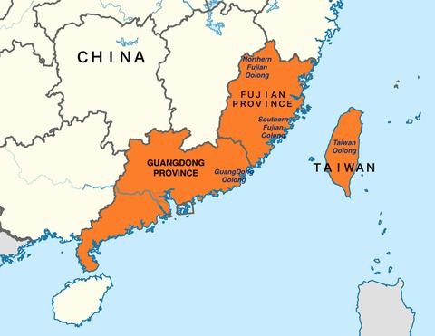
Oolong Varieties
North Fujian (Wuyi Shan)
Yancha
Ai Jiao Oolong
Ba Xian
Bai Ji Guan
Bai Rui Xiang
Ban Tian Yao
Bei Dou
Bu Lao Dan
Bu Zhi Chun
Da Hong Pao
Gold Peony
Huang Dan
Huang Guan Yin
Jin Fo
Jin Hua Xiang Yuan
Jin Mao Hou
Que She
Rou Gui
Shi Jiao
Shi Ru Xiang
Shui Jin Gui
Shui Xian
Tie Luo Han
Wu Yi Dan Cong
Wu Yi Qi Lan
Xiang Po Bei
Ye Lai Xiang
Zui Gui Fei
Zui Hai Tang
South Fujian (Anxi)
Tieguanyin
Huangyin Gui
Mao Xie
Fo Shou
Guandong
Dancong
Yu Lan Xiang
Xin Ren Xiang
Zhi Lan Xiang
Po Tou Xiang
Huang Zhi Xiang
You Hua Xiang
Mi Lan Xiang
Rou Gui Xiang
Gui Hua Xiang
Ye Lai Xiang
Mo Li Xiang
Ya Shi Xiang
Da Wu Ye
Song Zhong
Taiwanese
Baozhong
Dongding
Dongfang Meiren
Ruan Zhi
Jin Xuan
Tieguanyin
Gaoshan
Lishan
Alishan
Shanlixi
Dayuling

Slide 8
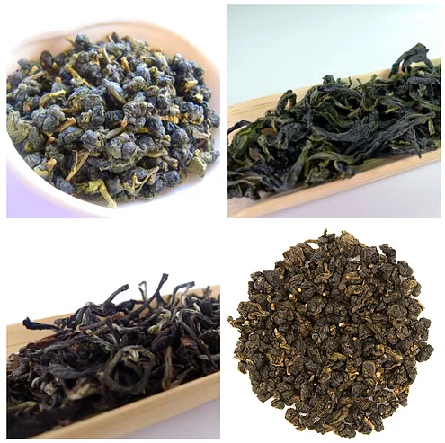
Taiwanese Tea Varieties
Gao Shan aka High Mountain
This name refers to any tea that is grown over 1000m elevation, and processed as a lightly oxidized, unroasted Oolong Tea.
Jin Xuan aka Milk Oolong
A hybrid of cultivars created in the 1980's by Taiwan's Tea Research and Extension Station (TRES), known as Tai Cha #12.
Dong Ding
Dong Ding is a mountain in Lugu, and now represents a processing method, using the original Qing Xin Oolong cultivar migrated from mainland China..
Dongfang Meiren aka Oriental Beauty
Harvested after leaves have been bug-bitten by the Jassid leaf hopper resulting in a distinct honey note in both the aroma and the flavor profile.
Sun Moon Lake Black Tea aka Red Jade
Tea cultivation in the Sun Moon Lake dates to the Qing Dynasty when Chinese settlers began cultivating the naturally occurring wild tea tree.
In the early 1900's, the Japanese colonists began large scale black tea production using an Assam strain, following the British model in India.
The pre-existing wild tea strain cross-bred with an Assam strain.
TRES spent 50 years refining this hybrid before registering it in 1999 as Tai Cha #18.
In 2003, it was given the name Red Jade at the 100-year anniversary of the TRES
Wenshan Baozhong
The least oxidized of the Taiwanese oolongs, with a distinct flavor between green tea and oolong.
Tieguanyin
Produced mainly in Muzha in the traditional roasted style of tieguanyin from Anxi, China.
Cui Yu aka Green Jade
Cui Yu or Tai Cha #13 is the name of this hybrid developed by TRES at the same time as Jin Xuan/Tai Cha #12.
Four Seasons Spring Oolong
In 1981, a Muzha tea farmer discovered a naturally occurring hybrid in his tea garden.
The name Four Seasons Spring is due to its year-round leaf growth, allowing for at least 4 harvests annually.
Sanxia Bi Luo Chun
Sanxia is a tea growing region just outside of Taipei, where Bi Luo Chun Green Tea is produced by an heirloom strain Qing Xin Gan Zai
These include: Lishan, Alishan, Shanlixi, Dayuling

Slide 9
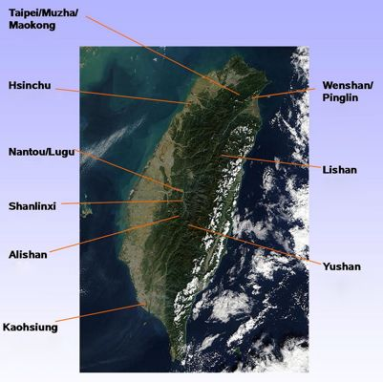
z
Taiwanese
Tea
Growing Regions

Slide 10
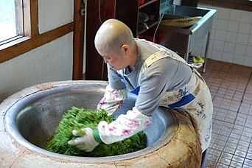
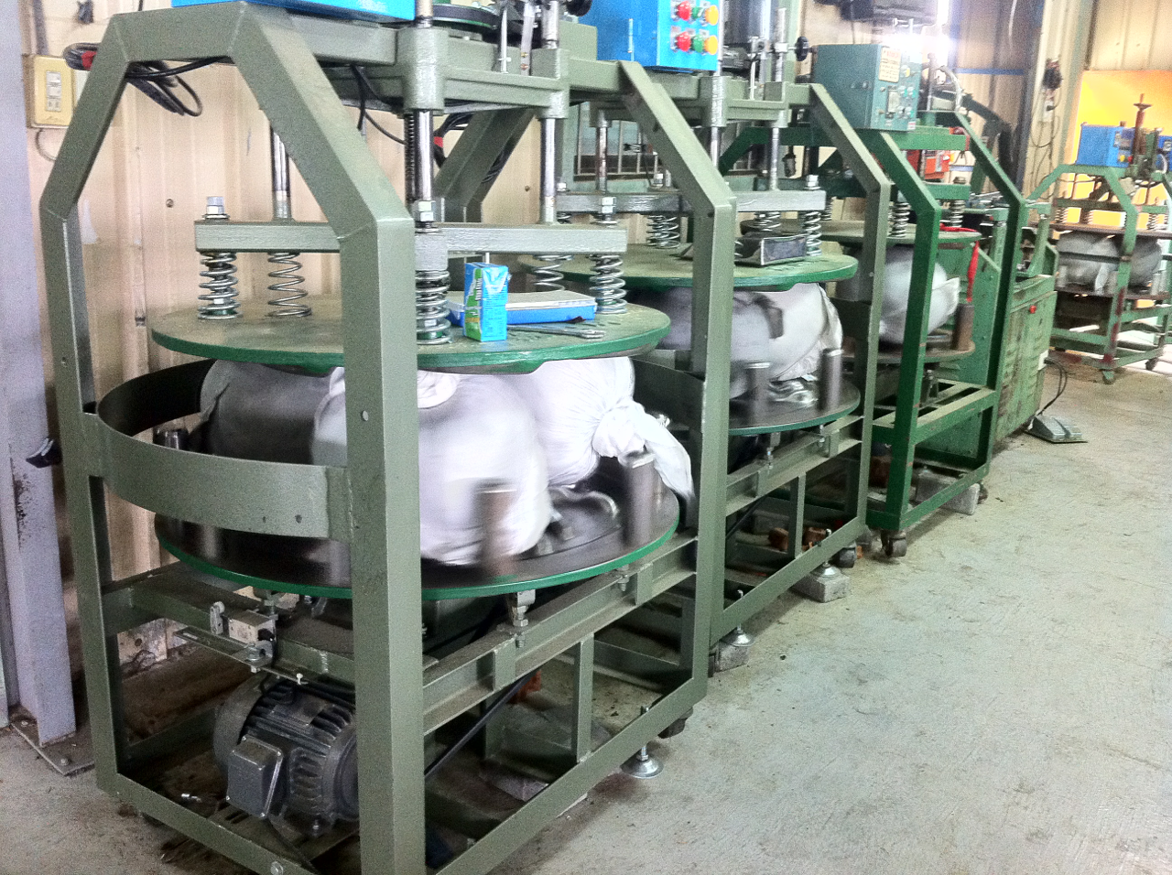
Picking.
Taiwan oolong can be harvested up to 6 times a year depending on the elevation and weather conditions.
High mountain tea may only be harvested 3 times a year because the weather is much cooler and the tea grows more slowly.
The best quality oolong tea is hand-picked.
The tea leaves are picked as they are budding.
Two leaves along with the bud are plucked from the tea bush and placed in a large basket that the picker carries on her back.
The fresh leaves are transported back to the facility for processing tea.
Drying
The leaves are spread on a flat surface and exposed to the sun for about an hour.
Afterwards they are gathered and placed on drying racks in an air-conditioned drying house.
Shaking
The leaves are shaken every hour so that the edges of the tea leaves bruise and oxidize.
The tea leaves will lose approximately 20% of their moisture content during step in producing oolong tea.
They also begin to turn brown due to the oxidation process.
Kill Green
To halt the oxidation the tea must be pan-roasted.
The decision of when to roast the leaves depends on the judgment of the tea master.
Oolong tea is usually oxidized between 20% and 80%.
The tea master makes his decision of the level of oxidation depending on the type of leaves and the desired finished product.
Rolling
The leaves are tightly packed in a canvas cloth and placed in a rolling machine.
They are rolled for about 15 to 20 minutes, then again roasted.
This rolling and roasting process is repeated up to 20 times.
The variables in tea production include
Initial drying time
Time spent in the drying house
Frequency of tossing
Initial roasting time
Number of times the leaves are rolled and re-roasted
Changing any of these variables results in a noticeable difference in the final product.
Tea production is labor intensive and the major reason why first grade oolong is so expensive
Regardless of the price, there is strong domestic market for top-quality oolong tea
Most of the oolong tea produced in Taiwan is for local consumption.
Processing

Slide 11
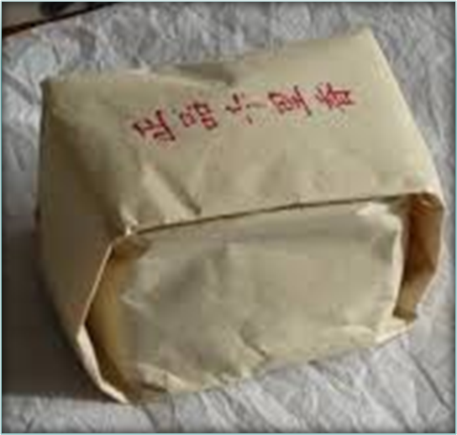
Bao Zhong Oolong
z
Literally ‘wrapped kind’
Referred to as Wenshan Baozhong, since the geographic designation in northern Taiwan was referred to as the Wenshan district during the Japanese occupation.
Wen Shan is the range of mountains that surround Taipei in northern Taiwan
Pouchong is another name for Baozhong tea.
It is from an older method of transliteration known as Wade-Giles, which is no longer used.
A light oxidized oolong tea, typically between 8%~18%
Known for its vegetal and floral characteristics.
Baozhong is considered a “green oolong tea” as it is mildly grassy and oceanic in aroma, like a green tea.
Traditional Baozhong making techniques do not involve roasting but roasted varieties are available today.
produced in the northern part of Taiwan, predominantly in the Pinglin District of New Taipei.
Cultivars used;
Camelia Sinensis Sinensis
Qingxin
Jinxuan aka Milk Oolong
TRES No.12
Picking Standard
Three leaves plus a bud

Slide 12
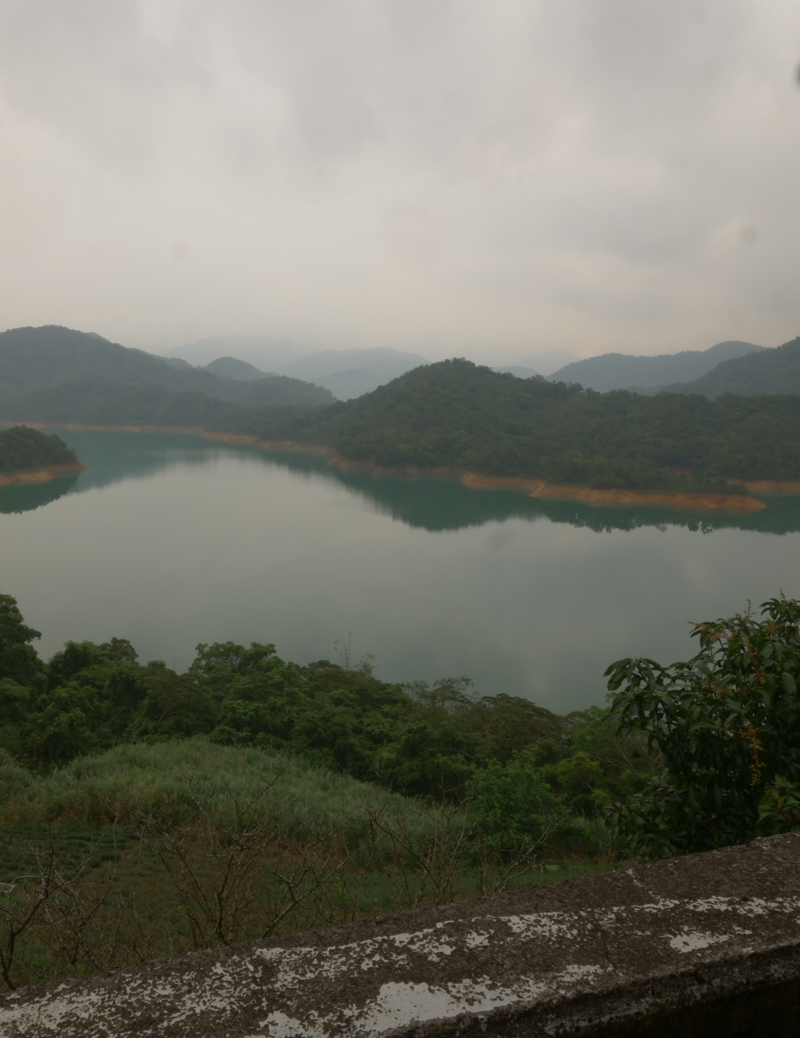
Bao Zhong Origins
z
In 1881, Fu Yuan Wu brought into Taiwan a new method of tea production from Anxi Fujian, to increase demand.
The new and improved method of tea-making included cultivating Qingxin tea cultivar, producing the tea into a green oolong, then gently infusing the floral scents by rubbing freshly bloomed flowers with the dried oolong tea leaves in repetition.
In 1912, small localities in Taiwan figured out a way to produce floral oolong tea without scenting the tea with flowers through contact, which was extremely costly and labor-intensive.
This newly created loose leaf oolong was then wrapped with a square rice paper, typically stamped with the tea company seals.
That’s where Baozhong got its name which phonetically translated from its Chinese name “wrapped kind” which refers to the paper packaging used in the past.
The leaves were packed in squares of paper rather than into a tin or a box.
Each packet contained about 150g of tea.
Since this packaging was not air-tight, the tea would continue to slowly oxidize over time.
This style of production was the foundation of the modern Baozhong oolong tea from Pinglin, Taiwan.

Slide 13
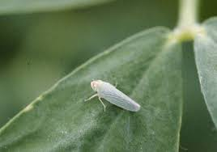
Bug-Bitten Teas
Bug bitten teas are a specialty of Taiwan
They are created by allowing small green leafhoppers, known as a tea jassid, technically a jacobiasca formosana, to attack the tea plants prior to harvest.
When bitten by the jassid, the tea plants release specific volatile aromatic compounds which repel the bugs, but to the human palate are surprisingly reminiscent of honey.
Examples of bug bitten teas
Dong Fang Mei Ren aka Oriental Beauty
Gui Fei aka Royal Concubine Oolong
Mi Xiang aka Honey-Aroma
The effect of the leafhopper depends on
The cultivar
Different cultivars of tea plant respond differently to leafhoppers.
Longjing will defend itself against insects by producing more caffeine, which would lead to a more bitter tea
Qing Xin defends itself against insects by producing hotrienol, a chemical which attracts predators of the tea jasid, and is also responsible for the honey aroma we enjoy so much in bug bitten teas
The age of the leaves
Leaves of different ages react differently to insect damage.
Most green teas are produced with only one or two leaves and a bud while most oolongs are produced with older leaves.
The leafhopper produces undesirable chemical changes in young leaves and desirable changes in older leaves.
In green tea production, you’re only getting the bad changes, In oolong production, the good changes outweigh the bad ones.
The processing method.
The leafhopper causes the same chemical changes in all tea plants, but those chemicals get modified by different processing methods to create differences in the processed tea.
A leafhopper causes tea plants to produce compounds that when left unoxidized—as they would be in a green tea—produce undesirable flavors.
When the leaves are oxidized as in oolong processing, they become compounds with desirable characteristics in the finished tea
z

Slide 14
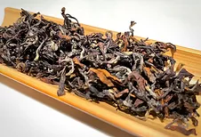
Oriental Beauty
z
A highly oxidized (+/-70%) oolong harvested from young summer leaves, just after they have been bitten by the tea jassids.
Originated in the Hsinchu province of Taiwan
Created in 1932 by an unnamed tea farmer from Beipu
Tea farmers were upset because their crops were being eaten by small insects
They didn't harvest the bitten leaves, because this low-quality tea was usually turned down by the foreign tea traders.
The unnamed tea farmer harvested these bitten leaves
The farmer bragged to his friends about the high price he was able to sell this tea for after a local competition, and it was subsequently named "Peng Feng Cha" or bragger's tea by the locals.
The tea made its way to the queen of England who named it "Oriental Beauty"
The tea was exhibited at the 1935 Taipei International Exposition held by the Japanese colonial government to showcase Taiwan’s successes under Japanese rule.
Other names
Bai Hao Oolong - ‘White Hair Oolong’
Referring to the hairy fur on the dry leaves
Wu Se Cha - ‘5 Colors Tea’
Referring to the different colors in the dry leaves.

Slide 15
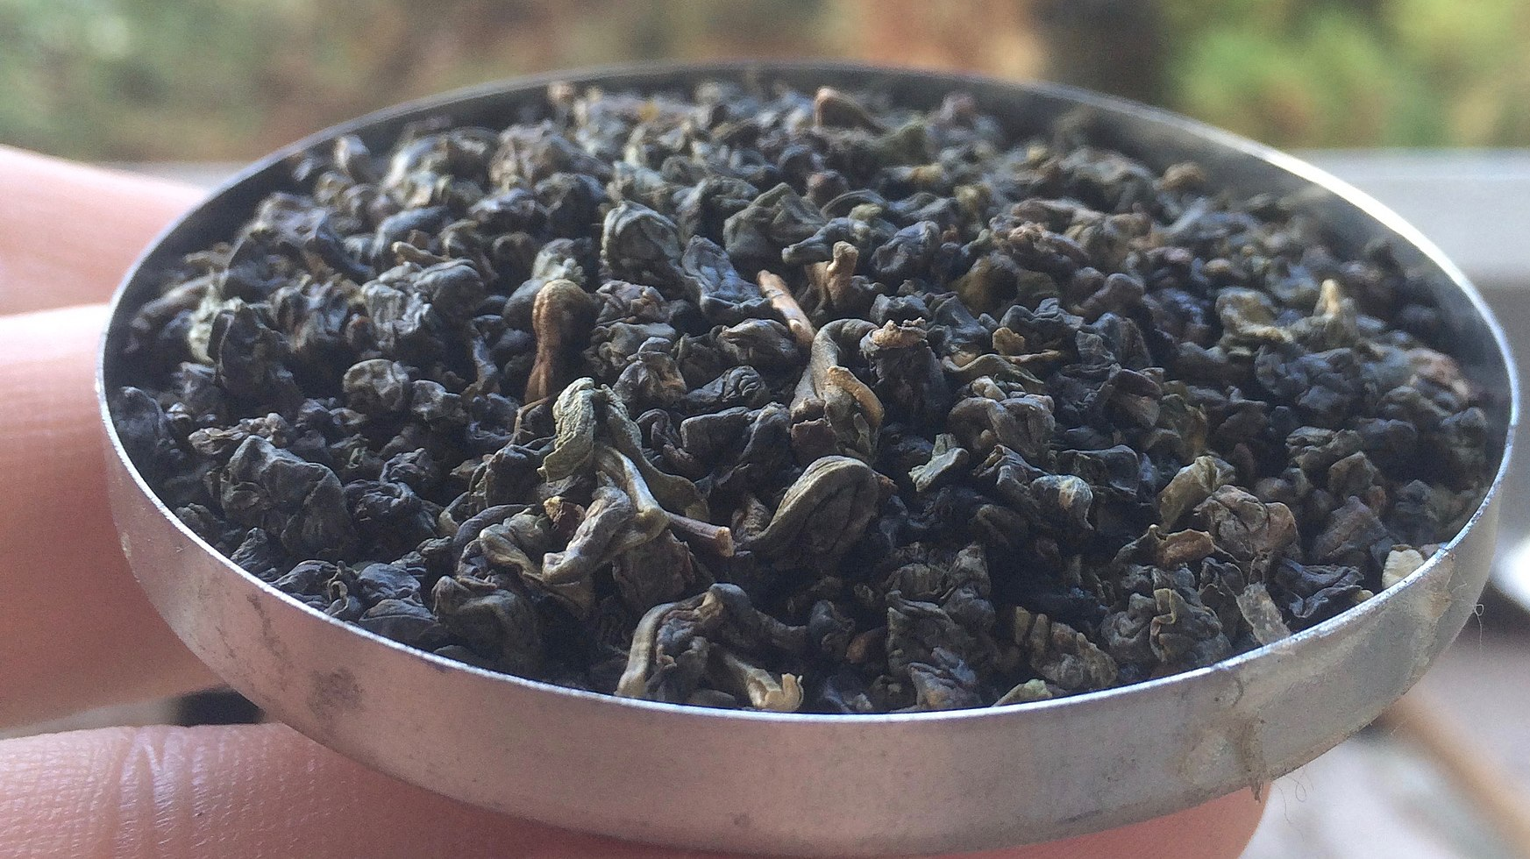
Dong Ding Origin
z
The name Dong Ding means “frozen peak,”
There is no ice on Dong Ding Mountain
The tea grown is grown at altitudes of 600 to 1800 meters
Tea grown above 1000 meters is considered “high mountain tea”.
The name dong ding originated due to how steep the mountain is
People had to walk on their tiptoes to climb it.
In the Taiwanese Hokkien/Minnan (台語／閩南話) language this is referred to as “grasping the peak”, which happens to sound like “frozen peak” in Mandarin
Around 1885 the scholar Ling Fong Chi went to China to study.
When he returned to his home in Lu Gu on Dong Ding Mountain, he brought with him 36 tea plants from Wu Li Shan as gifts for relatives who had supported his stay in China.
He gave away 32 of the plants and kept 4 for himself.
All 36 plants were grown in the Lu Gu area which has an elevation of 743 meters.
.
This Photo by Unknown Author is licensed under CC BY-SA

Slide 16
Tieguanyin
z
Named after the Goddess of Mercy
Originated in Fujian
Taiwanese Tieguanyin is usually Muzha Tieguanyin
Muzha is in Northwest Taiwan
It is heavily roasted t is commonly aged.

Slide 17
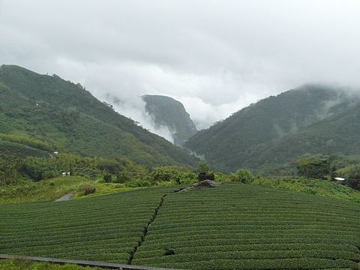
Grown at altitudes of 1,000 meters or above.
Grows slowly due to the thin air in high altitudes
Low oxidation of around 30%
Relatively low yearly yeild.
Types of Taiwanese High Mountain Oolong
Lishan
Grown at altitudes from 1600-2600 meters on Lishan
Fu Shou tea is grown from the peak of Lishan
Alishan
This is the most widely known high mountain tea
Grown at altitudes from 1000-2300 meters on Alishan
The tea leaves are rolled into dense little balls that unfold when you add hot water.
Much of it is picked in winter and therefore termed “winter tea”.
Among the oolongs grown on Alishan, tea merchants tend to stress the special qualities of the Jin Xuan cultivar, which was developed in Taiwan in the 1980
The oolong tea made with this cultivar has a particular milky flavor.
However, in some regions, such as where Alishan zhulu tea is grown, the most prized are the ones made with the Qing Xin cultivar.
Tea made with this cultivar has a floral and ripe-fruity aroma.
Shanlixi
Named after it’s growing area.
Grown between 1,200-1900 meters in a forested area with rainfall throughout the year.
Hand-picked and rolled
Particularly in-demand are Longfengxia teas from Shan Li Xi.
Longfengxia is a term used to designate the highest peaks in the growing region (~1,900 meters). Dayuling (大禹嶺)
Dayuling
Grown at altitudes of 2400-2500 meters on top of Lishan..
Sometimes referred to as the King of Taiwan high mountain tea.
Due to the limited production of this tea, the it demands a high price
High Mountain Oolong (Gao Shan)

