Slide 1
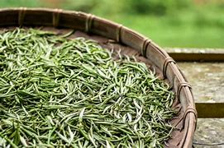
Presented By:
New York Tea Society

Slide 2
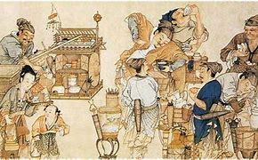
HISTORY
SONG DYNASTY
The word "white tea" (baicha) first emerged in Emperor Song Hui Zong's ‘Daguan Chalun’ in the 12th century:
White tea is rare
It grows in the cliff
Is available in 4 or 5 places
In 1 or 2 tea bushes at a time
Some experts mistook this for white tea.
Emperor Song Hui Zong was referring to tea plants with white leaves, the popular Anji Baicha, which has white colored leaves, however, it is processed like green tea, and so is considered a green tea, not white tea.
MING DYNASTY
The first written records of white tea appeared in Tian's Zhuquan Xiaopin in 1554:
Making tea with fire is second best
It is far more natural to make tea with sun
Pure and bright
Lovely to drink
18th Century
Silver Needle or Baihao Yinzhen was 1st produced in Fuding County in Fujian Province during the 18th century
In 1857, the Fuding Dabai tea plant, native to Fuding's Taimu Mountain, was successfully cultivated.
Its enormous buds and showy white hairs make it ideal for making Silver Needle.
Production started in 1885.
It instantly began selling for 10 times more than its predecessor.
In 1880, Zhenghe County cultivated the Zhenghe Dabai tea plant and in 1889 began production.

Slide 3
PROCESSING
Picking
Baihao Yinzhen: unopened buds only
Withering
Best outdoors in the sun
Spread on large bamboo mats
High temp/low humidity is best
Indoor phase under controlled conditions follows the outdoor phase
Natural oxidation occurs during this process
Drying
Can initially be heated to over 100 Celsius
Bai Mudan: 1 unopened bud+1-2 leaves
Gong Mei: 1 bud +more than 2 leaves
Shoumei: low bud to leaf ratio, many older, bigger leaves
Very gentle final drying with relatively lower temos
Traditionally: Charcoal Roasted
Modern: Air Dried

Slide 4
TYPES OF WHITE TEA
Baihao Yinzhen Silver Needle
Bai Mudan White Peony
Shou Mei Noble Eyebrow
Gong Mei
Tribute eyebrow
Lao Bai Cha
Aged White Tea
Yue Guang Bai Moonlight White

Slide 5
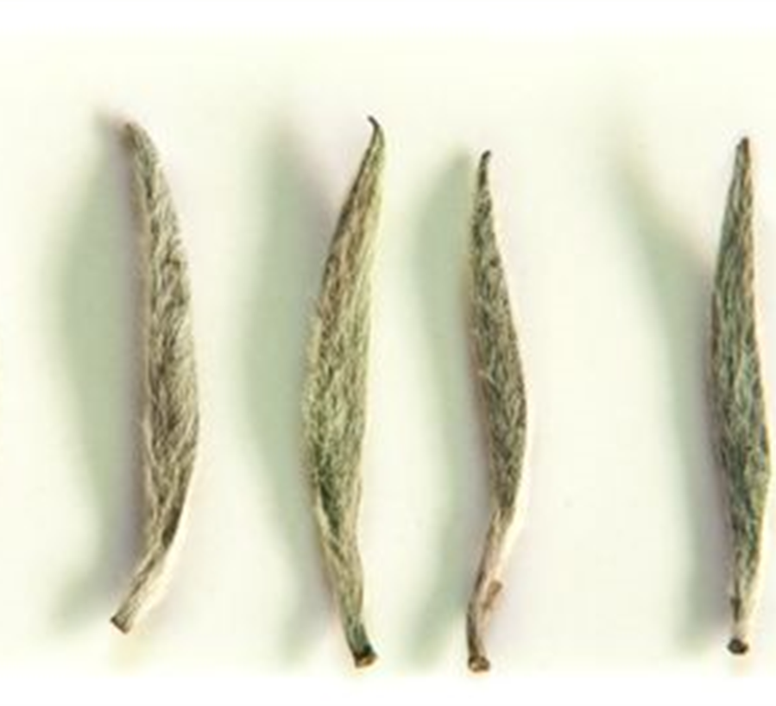
Silver Needle Baihao Yinzhen
Baihao Yinzhen is processed from all bud material
Baihao Yinzhen aka Silver Needle was 1st produced in Fuding County in Fujian Province during the 18th century
The cultivar used in those days yielded a product that was only half of the size of the present version and not as downy.
In 1857, the Fuding Dabai tea plant, native to Fuding's Taimu Mountain, was successfully cultivated.
Its enormous buds and white hairs make it ideal for making Silver Needle.
Fuding Silver Needle production started in 1885.
It instantly began selling for 10 times more than its predecessor.
In 1880, Zhenghe County cultivated the Zhenghe Dabai tea plant and in 1889 began production

Slide 6
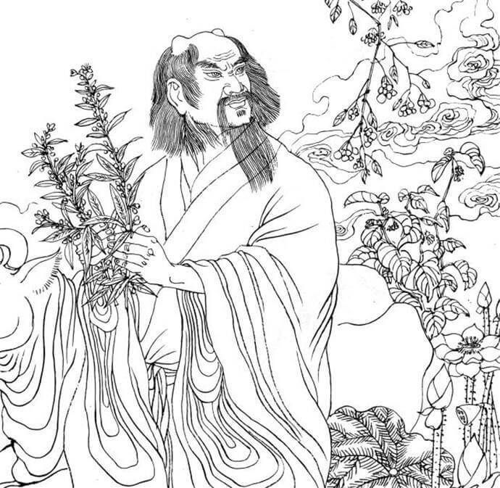
The Legend of Baihao Yinzhen
A long time ago, the village of He Zheng suffered a plaque resulting from a long period of drought.
On the hills of the nearby Dong Gong mountain grew a heavenly herb that can cure all kinds of diseases.
Because of the plague, many brave men climbed up the mountain in search for the heavenly herb, but never returned.
There was a family with 3 children named Zhigang, Zhicheng, and Yu Chi, who were determined to find the herb.
The oldest brother decided to go first and met an old man near the mountain.
He told him that the herb is near a well on top of the mountain, but you can only succeed if you keep climbing up the hills until you find the herb, before ever considering to return.
Zhigang started climbing and halfway up, he saw many stones, without any sight of the herb.
Then he suddenly heard a voice: “don’t dare to climb further!”
He was shocked and decided to walk back and suddenly turned into a stone himself.
As Zhigang didn’t return, Zhicheng decided to climb up Dong Gong mountain, and unfortunately faced the same fate.
It was now little sister Yu Chi’s turn.
After she departures she met the same old men, and he provided the same advice.
The old men this time also offered her some baked rice cake for her journey.
As she arrives at the same place with the same strange voices warning her to return, she used the rice cake to cover her ears and continued to move forward.
She finally arrived at the hilltop and found the heavenly herb that grows next to the well.
She used the water from the well to irrigate the plants and they started to grow and reveal flowers.
She collected the seeds and brought them back. T
hen she grew the heavenly plants at the village to use them to cure diseases.
As it turns out, the heavenly herb is the tea plant that is today used to harvest fine tea buds covered with white hairs known as the Silver Needle white tea.

Slide 7
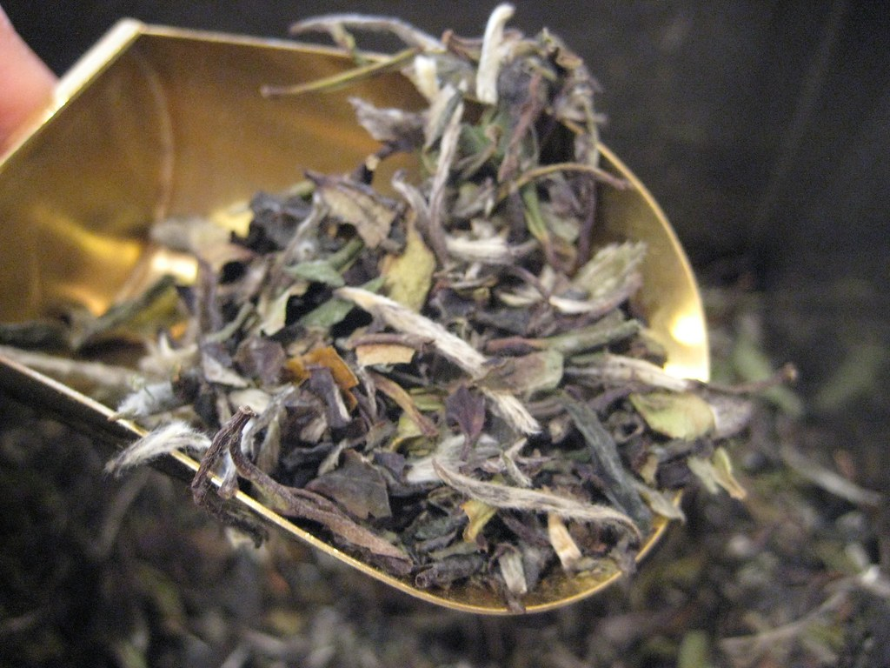
Bai Mudan White Peony
Bai Mudan translates to White Peony
It is processed from 2 leaves and a bud harvested in mid-April after the individual tea buds have been gathered for Baihao Yinzhen
It is fruitier and darker than Silver Needle, yet not as strong as Shou Mei.
The finest quality should have a shimmering clear infusion with a delicate lingering fragrance and a fresh, mellow, sweet taste devoid of astringency and grassy flavors.
Bai Mu Dan style is often preferred by white tea drinkers for its fuller flavor and greater potency than the Bai Hao Yinzhen style tea.

Slide 8
Gong Mei / Shou Mei Tribute Eyebrow / Noble Eyebrow
Both gong mei and shou mei are processed from leaves harvested after bai mudan from leaves deemed unsuitable to be processed as silver needle or white peony.
The difference between the two is that gong mei is processed from leaves of a higher grade than shou mei.
Because they are both more oxidized, due to being harvested later in the season, they take on a darker color and bolder flavor.
They are both often used in compressed white tea cakes

Slide 9
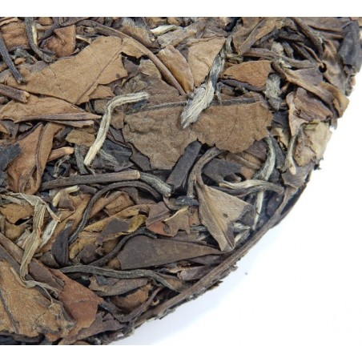
Lao Bai Cha Aged White Tea
White tea continues to oxidize very nicely during storage
The longer they are stored, the richer and mellower they will be.
There is a famous saying about aged white tea in China
one-year tea,
three-year medicine
seven-year treasure

Slide 10
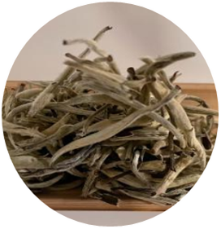
Yue Guang Bai Moonlight White
Yue Guang Bai translates to Moonlight White.
Supposedly the teas name is derived by the production method of being allowed to air dry overnight in the moonlight.
However, as this tea has gained in popularity it is now being dried indoors with warm air.
Drying the leaves in this method takes longer than drying in the sun, adding that extra level of oxidation sweetness over traditional white teas.

