Slide 1
WuyiShan Yancha
Presented By:
New York Tea Society

Slide 2
Introduction
Wuyi Shan has a rich cultural history dating back to the Shang Dynasty and an equally as impressive tea history which dates to the Tang Dynasty.
Wuyi Shan farmers produce the worlds most famous Chinese black teas and oolong teas,
Lapsang Souchong (“Original Mountain Small Kind”)
Jin Jun Mei ('Golden Horse Eyebrow')
Da Hong Pao ('Big Red Robe')
Tieluohan ('Iron Arhat')
Bai Jiguan ('White Cockscomb')
Shui Jin Gui ('Golden Water Turtle')
Rou Gui ('Cinnamon Scent’)
Shui Xian (Water Lily)
Qilan ('Rare Orchid’)
The terroir combined with the highly skilled production methods of wuyi shan is the key behind the unique flavors of wuyi shan cliff teas.

Slide 3
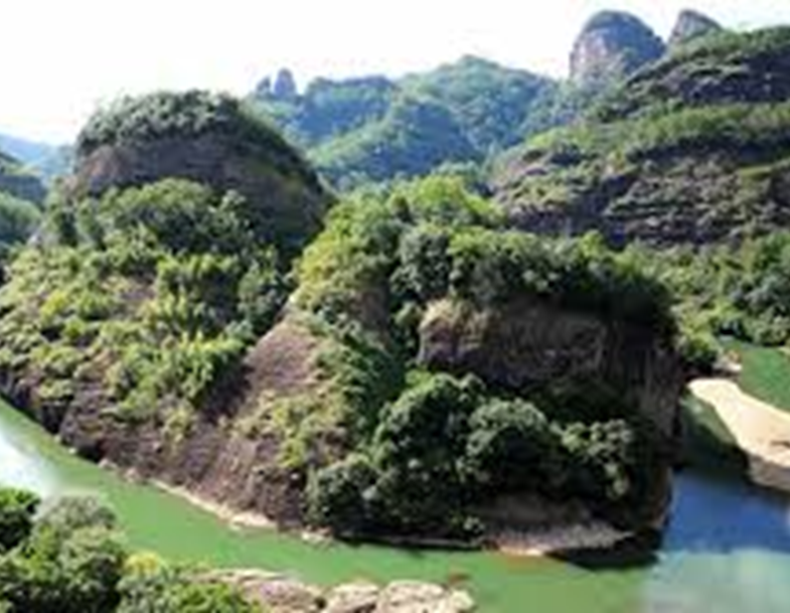
UNESCO -
WORLD CIULTURAL HERITAGE
Inscribed as a World Cultural Heritage Site in 1999
Contains the largest most representative example of a largely intact forest
Encompasses the diversity of the Chinese Subtropical Forest and the South Chinese Rainforest.
Acts as a refuge for an important number of ancient plant species, many of them endemic to China
Contains an extremely rich flora and fauna, including significant numbers of reptile, amphibian and insect species.
The serene beauty of the dramatic gorges of the Nine-Bend River is of exceptional scenic quality.
Situated along the Nine-Bend River are numerous temples and monasteries, many now in ruins, which provided the setting for the development and spread of Neo-Confucianism including;
35 Confucian academies dating from the Northern Song to Qing Dynasties (10th-19th Century CE)
Tombs, inscriptions & rock shelters with wooden boat coffins dating to the Shang Dynasty (2nd century BCE),
The remains of more than 60 Taoist temples and monasteries.
In the 1st century BCE a large administrative capital was built at nearby Chengcun by the Han Dynasty rulers. Its massive walls enclose an archaeological site of great significance.
The property consists of four protected areas:
Wuyishan National Nature Reserve in the west,
Nine-Bend Stream Ecological Protection Area in the centre
Wuyishan National Scenic Area in the east
Protection Area for the Remains of Ancient Han Dynasty is a separate area, about 15km to the south-east.
Totals 107,044 ha, the property is surrounded by a buffer zone of 40,170 ha

Slide 4
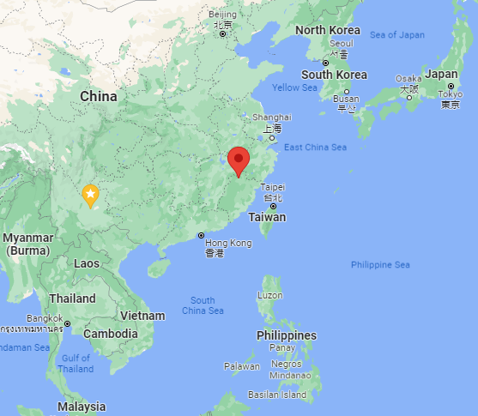
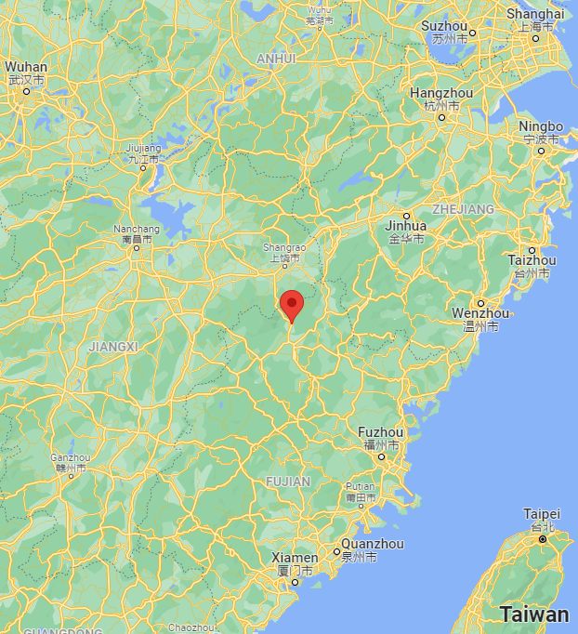
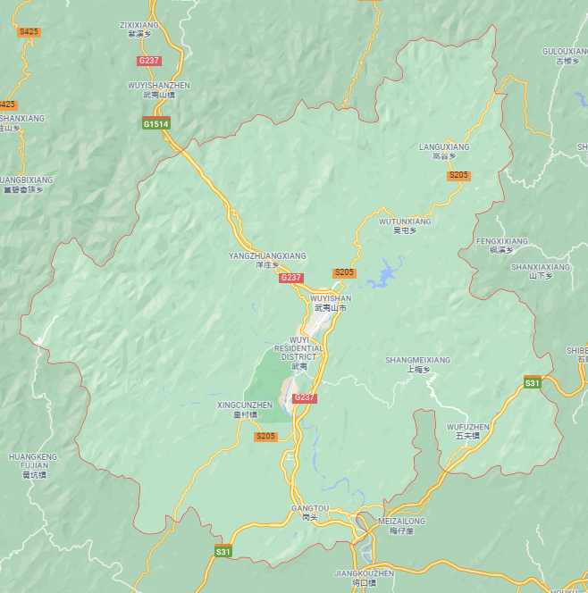
Geographic LOCATION

Slide 5
Yancha REGIONS

Slide 6
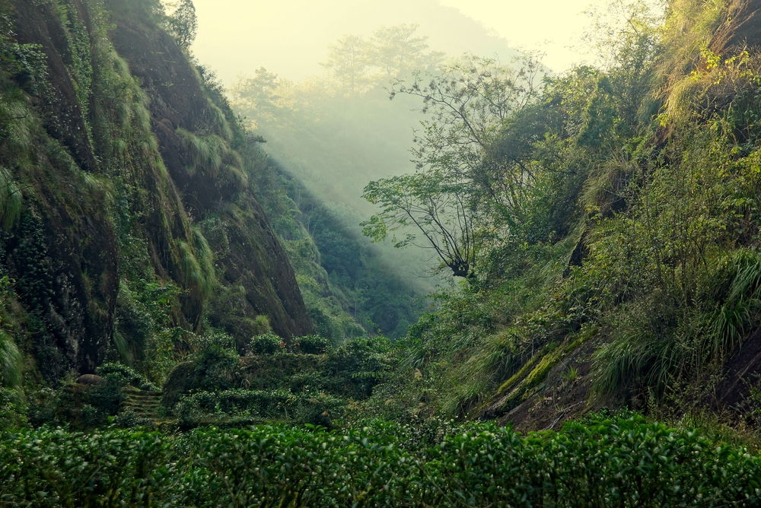
Zhenyan
‘Zheng Yan’ (‘Original Rocks’)
the traditional core area of cultivation and processing of Wuyi Yancha Oolongs
Identical with UNESCO’s Wuyi National Scenic Area protection zone
Applies equally to Lapsang black teas
The best Zhengshan tea cultivation terrains are located at relatively low altitudes of 300-700 m only.
Rock, soil, and the special climate conditions within Zhengshan in general and within the gorges, in combination with this level of altitude create conditions that are unique amongst notable venues of tea cultivation.
It is these conditions that coin the character of Wuyi rock teas.
Within the ‘Zhengshan’ area, there are several individual ‘pits’ and ‘gullys’, each of which is known for its suitability for one or more specific Wuyi Oolong tea cultivars.
Originally, there were only 5 such gorges (‘3 pits and 2 gullys’)
Huiyuan Pit
Niulan Pit
Daoshui Pit
Liuxiang Gully
Wuyuan Gully

Slide 7
Wuyishan zhengyan variety’s favorite growing region
Chinese | Pinyin | English | Rou Gui | Shuixian | Laocong Shuixian | Shui Jin Gui | Tie Luo Han | Bai Ji Guan
慧苑坑 | Huiyuan Keng | Huiyuan Pit | x | x | x |  | x | x
牛栏坑 | Niu Lan Keng | Bullpen Pit | x |  |  | x
竹窠 | Zhu Ke | Bamboo Nest |  | x | x
古井 | Gu Jing | Ancient Well |  | x | x
马头岩 | Ma Tou Yan | Horse Head Cliff | x
鬼洞 | Gui Dong | Ghost Cave | x | x | x |  | x | x
猪仔洞 | Zhu Zai Dong | Pig Cave | x
刘官寨 | Liu Guan Zhai | Liu Guan Village | x
九龙窠 | Jiu Long Ke | Jiu Long Nest | x | x
天心岩 | Tian Xin Yan | Heavens Heart Cliff | x
大坑口 | Da Keng Kou | Large Pit Mouth | x | x | x
三仰峰 | San Yang Feng | Three Up Peaks |  |  | x
流香涧 (倒水坑） | Liu Xiang Jian (Dao Shui Keng） | Flowing Aroma Stream (Falling Water Pit) |  | x
悟源涧 | Wu Yuan Jian | Origin Source Stream | x | x

Slide 8
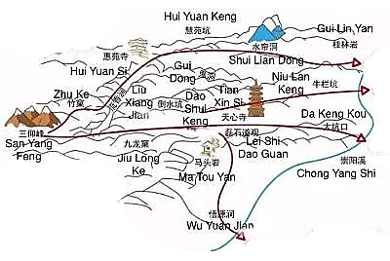
Famous Wuyishan
Zhengyan Areas

Slide 9
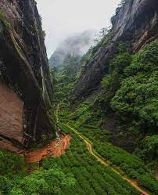
Famous Zhengyan Regions
Keng, Jian, & Ke
Keng (坑)
Literally, a Keng means a concave ground.
It usually has only one or two exits.
typically narrow, crooked valleys with moderate elevation differences.
Because a Keng doesn’t have one large flat field, tea plants are scattered in random places.
Famous Kengs
Niu Lan Keng (牛栏坑)
most renowned premium tea-producing location
Dao Shui Keng (倒水坑)
Hui Yuan Keng (慧苑坑)
Da Keng Kou (大坑口)
Jian (涧)
small water stream in between two adjacent mountains Wu Yuan Jian (悟源涧)
Because of Wuyi mountains’ unique landform, there are weathered sedimentary rocks piled up along the water stream.
the abundant water supply provides tea plants with a humid growing environment.
Mountains on the side shield tea plants from direct sunlight
Famous Jians
Liu Xiang Jian (流香涧)
Zhang Tang Jian (章堂涧)
Ke (窠)
Ke means the burrow or nest of insects, birds and small animals.
very similar to a Keng, however, a Ke is smaller and more diverse.
Some Ke have water streams, and some are in cool and humid places.
Famous Ke’s
Jiu Long Ke (九龙窠)
birthplace of Da Hong Pao mother plants
Zhu Ke (竹窠)
Yun Ke(云窠)
Yan Zi Ke (燕子窠)
Feng Shu Ke (枫树窠)

Slide 10
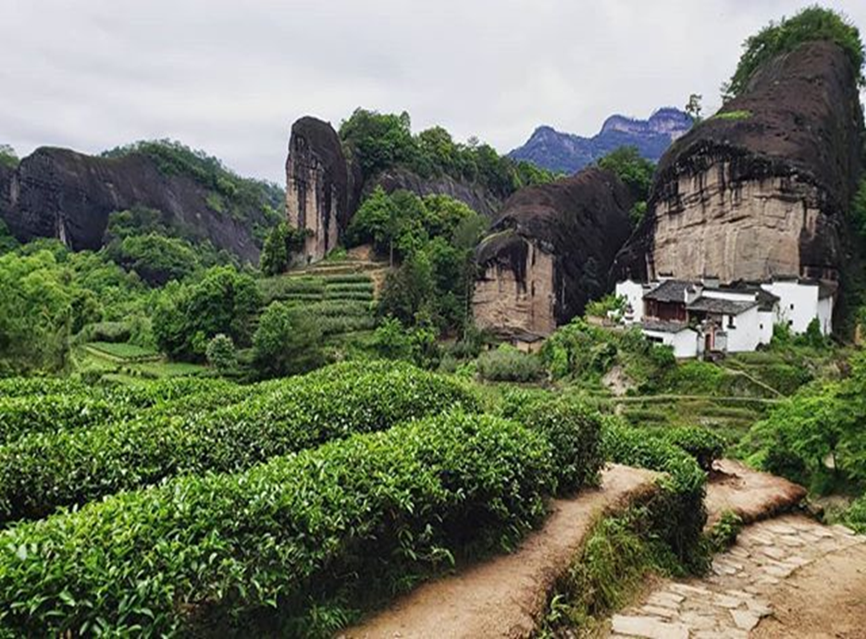
Famous Zhengyan Regions
Yan, Dong, & Feng
Yan (岩)
“Yan” means rock
Contain fertile soil and plenty of sunlight
Tea plants growing here can acquire and generate an abundance of fragrance
Famous Yan
Ma Tou Yan (马头岩)
Rou Gui from Ma Tou Yan is on an equal footing with Niu Lan Keng’s
Bi Shi Yan (碧石岩)
Fo Guo Yan (佛国岩)
Dong (洞)
Dong means caves.
Caves have their own small climates
Caves can maintain a relatively constant temperature.
Plants growing in caves enjoy a shady and cool environment.
Famous Dong
Gui Dong (ghost cave/鬼洞)
Gui Dong (ghost cave) produces one of the best Iron Luo-Han. Gui Dong’s small production makes its Iron Luo-Han a rare find.
Shui Lian Dong (水帘洞)
Man Tuo Dong (曼陀洞)
Yu Hua Dong (玉华洞)
Feng (峰)
Feng means mountain peak
Depending on where exactly tea plants grow, teas from a “Feng” taste differently.
Tea plants from the top of the hill will stronger aroma but a thinner tea soup
Tea plants from the mountainsides will have a balanced aroma and taste
Tea plants from the foot of the hill will be thicker but smell more delicate.
Famous Feng
Yu Zhu Feng (玉柱峰)
San Yang Feng (三仰峰)
Lian Hua Feng (莲花峰)
Ma Zhen Feng (马枕峰)
Man Ting Feng (幔亭峰)

Slide 11
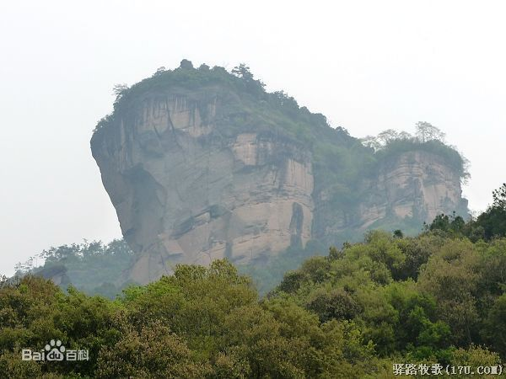
Famous Zhengyan Regions
Wo
Wo (窝)
The literal meaning of “Wo” is a nest
Like a “Keng but surrounded by mountains.
A “Wo” terrain can greatly protect tea plants from natural disasters such as spring frostbites.
In extreme weather, tea plants inside a “Wo” are guarded by mountains.
No hard winds can blow through, and no cold air can infiltrate.
Because of Wo’s protection, tea plants can freely grow without natural or human interference.
Famous Wo
Yun Wo (云窝)
~~~~~~~~~~~~~~~~~~~~~~~~~~~~~~~~~~~~~~~~~~~~~~~~~~~
General Characteristics
Thicker Tea Soup
Keng
Jian
Ke
Wo
Dong
Stronger, More Complex Aromas
Feng
Yan

Slide 12
Banyan, Zhou Cha, Wai Shan
‘Ban Yan’ (‘half-rock’).
The area adjacent to the Zhengshan zone
In parts of the Banyan area, geological, soil and climate conditions are nearly identical with those in the Zhengshan area.
These terrains are home of some traditional tea plantations, whose rock teas can be put on one level with those from Zhengshan area, or at least close to that.
Today, the best Yancha Oolongs from the Banyan area might even be better than Zhengshan Yanchas of lower or medium quality.
‘Zhou Cha’ (verbally: ‘river tea’) area,
Located adjacent to the ‘Banyan strip’ in western direction
consisting of the banks of the Nine Bends River and adjacent river valley areas
blessed with fertile soils and a great wealth of water
As much as this area might be suitable for tea cultivation (and more), the Oolong teas growing here – with cultivars mostly being identical with those in Zhengshan and Banyan areas – show only little of the rock charm of Wuyi Yancha Oolongs and are not considered as rock teas in a narrower sense
‘Wai Shan’ (‘outside the mountain’).
Areas located beyond the ‘Zhou Cha’ zone
Also here, fine Oolong teas are cultivated, which however do not qualify as Yancha (rock tea), due to missing specific properties.

Slide 13
Yancha Processing Steps – Part I
Picking
Hand-picked with mature leaves consisting of one bud and three to four leaves
Solar Withering
Fresh tea leaves are evenly spread on withering trays.
Trays are loaded onto the withering shelves for solar withering.
In order to have even withering, when the tea leaves are withered to a certain degree, they are gently piled and turned over manually without damaging the leaf.
The time for solar withering depends on conditions of the tea leaf and weather condition.
In general, it is within 2 hours.
Termination of solar withering is determined by a weight loss of 10-15% of the original weight of fresh tea leaf (i.e., the tea leaf retains about 65-70% of its moisture).
Indoor Sitting and Shaking
This is a quality-determining step in the manufacture of Wuyi Yancha.
Sitting and shaking are conducted alternately.
During shaking, the tea leaf moisture evaporates gradually and softens the tea leaf, whereas during sitting, moisture in the leaf veins diffuses to the rest of the leaf and hardens the tea leaf.
During sitting and shaking, the windows in the room must be closed, maintaining a stable temperature between 22 and 27°C and a relative humidity of 80-85%.
When room temperature is lower than 20°C, such as in spring with cool temperature and rainy days, supplemental heating is needed.
Shaking causes the leaves to roll and turn over on the trays, allows the leaves themselves and leaf and tray surface to rub against each other, damages the cells in the leaf circumference, and induces partial oxidation and reddening.
In general, the first shaking is conducted after sitting for 1 hour, followed by hourly shaking for 7-9 times.
Tea leaf that has undergone proper sitting and shaking has the following indicators:
spoon-shaped leaf with light green surface and bright reddish color circumference
leaf apex is prickly with a ''sa-sa'' sound when turned over lightly
transparent veins
disappearance of greenish odor with a light fragrant aroma
moisture content about 65%.

Slide 14
Yancha Processing Steps – Part II
Wok Frying and Rolling
Traditional manufacturing process includes two wok frying and rolling steps.
1st Wok Frying
Lasts for 5-7 mins until the tea leaf is soft and sticky to the hands, with disappearance of greenish odor and appearance of pleasant aroma.
1st Rolling
Tea leaves are transferred to the roller for rolling while tea leaves are still hot.
This primary rolling time is 2-3 mins.
Leaf juice is leached out with the tea leaf rolled to a stringy shape.
2nd Wok Frying
This tea leaf mass is broken up and again panned at 150-180°C.
This secondary panning is basically a stewed panning until the tea leaf is too hot for the hands.
2nd Rolling
The tea leaf is again rolled for a short time with pressure in order to tighten the stringy shape.
Roasting
Wuyi Yancha is generally dried in a two-step process.
1st Roasting
Over hardwood charcoal
Hire-fired teas can roast up to 20 hours
Low-fired teas are roasted for a much shorter time
Sorting
Smaller leaves are separated for premium tea
Larger leaves are used for lower grades
2nd Roasting
At least one more 2nd roast will be done
Higher grades of tea will undergo 3rd and/or 4th roasting depending on desired style of finished tea is desired
Roast taste and aroma are overly present in freshly processed rock tea.
High quality Wuyi Yancha Oolongs are therefore usually stored for at least 6 months before being brought on the market.

Slide 15
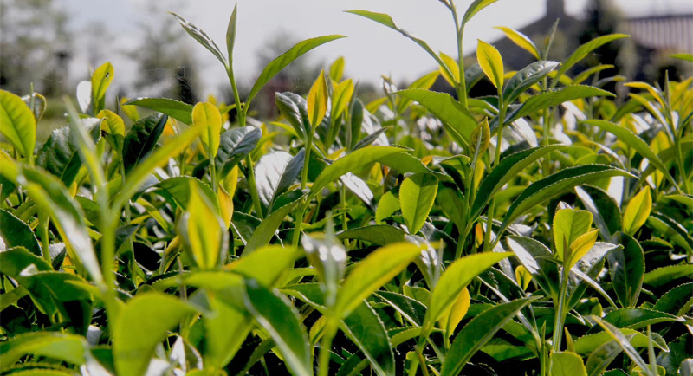
Si Da Ming Cong
Da Hong Pao – Big Red robe
Beidou
Qidan
Bai Jiguan – White Rooster Comb
Tie Luohan - Iron Arhat
Shui Jin Gui - Golden Water Turtle
Jiu Long Pao - Nine Dragon Robe
Fo Shou - Buddha
Yong Chun Fo Shou
Huang Guanyin – Yellow Goddess
Huang Meigui – Yellow Rose
Jin Guanyin – Golden Goddess
Jin Mudan – Golden Peony
Mei Zhan -
Zi Meigui – Purple Rose
Qi Lan – Rare Orchid
Rougui - Cinnamon
Shuixian – Water Lily
Lao Cong Shuixian – Old Water Lily
Wuyishan
Yancha
Varieties

Slide 16
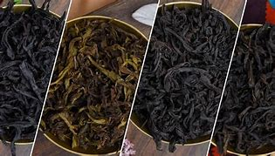
SI DA MING CONG
The Four Famous Bushes
While there are hundreds of cultivars grown on the Wuyi mountains, there are four specifically designated as Si Da Ming Cong (the four famous bushes).
Da Hong Pao - Big Red Robe
Tie Luohan – Iron Arhat
Shui Jin Gui – Golden Water Turtle
Bai Ji Guan – White Cock’s Comb
These teas are all heavily associated with tea lore, and all have debatably true origin stories.
Verified Si Da Ming Cong will also fetch very high prices on the open market.

Slide 17
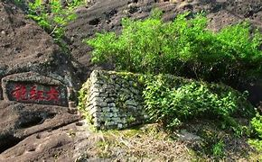
DA HONG PAO
Da Hong Pao (“Big Red Robe”) is one of the best-known varieties of Wuyi “Yan Cha” or “rock oolong” tea.
According to legend, in the days of the Ming Dynasty, the mother of a Chinese emperor recovered from a serious illness after drinking a particular tea.
Thereupon, the emperor had the five tea bushes, from which the tea had come, clad in in imperial red robes.
Four of the Da Hong Pao “mother bushes” remain today.
At 1st, the few hundred grams of the tea bushes’ annual yield were reserved exclusively for the imperial court.
In more recent times, the mother bushes have been subject to extensive scientific studies.
One result of these studies was the realization that the four shrubs are not of the same tea plant variety.
Two of the bushes belong to the Qidan variety.
Two of the bushes belong to the Beidou variety.
Distinguishing the tea from both bush types is quite a challenge even for well-practiced tea drinker.
Both leaves, dry and infused show a similar visual appearance.
The differences in taste between both varieties consist of no more than the finest nuances.
Towards the end of the 1980s, scientists finally managed to raise genetically identical tea plants from cutoffs of the mother bushes.
They distributed specimens of both varieties of these “first generation cutoffs” among Wuyi tea farmers.
Only this way, Da Hong Pao Oolong tea could become available to tea lovers across the world.

Slide 18
Tie Luo Han
Tie Luo Han is a translation Iron Arhat, Iron Buddha, or Iron Warrior Monk
“Tie” stands for “iron”, referring to the appearance of the tea leaves
“Luo Han”, stands for “arhat” that comes from the legend behind the origin of this tea.
“Arhat” also stands for the state of enlightenment that Buddhist monks reach.
It is said that this tea was first created by a powerful warrior monk with skin that was golden-bronze.
The tea was found in Gui Dong, ‘Ghost Cave’ in Hui Yuan Yan, near the temple of the Buddhist monks.
This tea dates back to the Song Dynasty

Slide 19
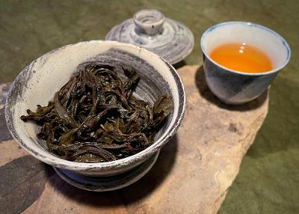
Shui Jin Gui
Shui Jin Gui means "Golden Turtle."
According to Chinese legends,
Shui Jin Gui tea plant is a transformation of a turtle god.
Despite achieving godhood after a thousand years of meditation, the turtle god soon felt discontented as his hard effort as the Heaven’s Tea Gardener was not appreciated.
One morning, he awoke to the noise of tea farmers celebrating their harvest of first flush tea leaves happily.
Upon seeing this, the turtle god realized that he would be better appreciated as a tea plant and thus he gave up his immortality to become the Shui Jin Gui tea plant.

Slide 20
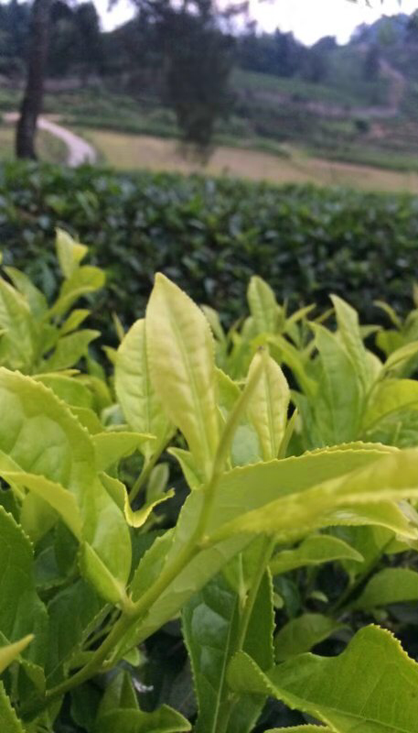
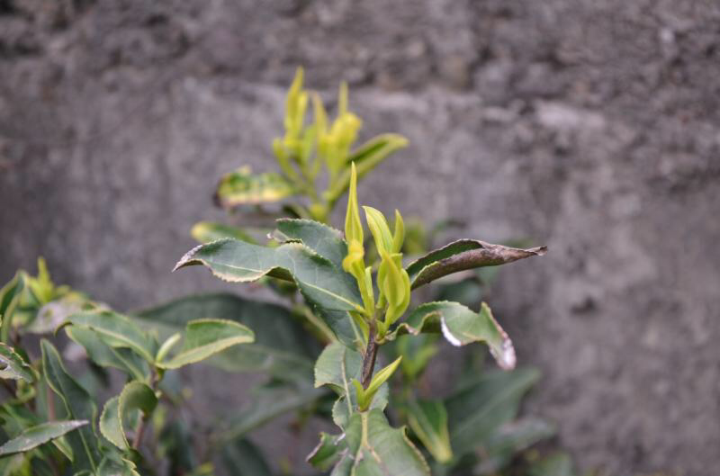
Bai Ji Guan
Bai Ji Guan translates to ‘white cockscomb'
Legend has it that the name was given by a monk from Huiyuan Temple in memorial of a courageous rooster that sacrificed his life while protecting his baby from bird of prey.
Touched by the display of courage and love, the monk buried the rooster and from that spot a tea tree grew with pale, almost white leaves, curled up in the shape of a cockscomb.

Slide 21
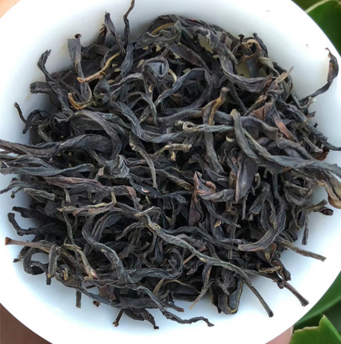
Shui Xian
Originally transplanted from Fenghuang Shan in Chaozhou.
Shui Xian is is named after the Narcissus plant, known as a daffodil in English.
It also goes by the names
Shui Hsien
Narcissus
Water Fairy
Water Lily
Water Sprite
It is one of the most popular varietals in Wu Yi Shan today
Types of Shuixian
Lao Cong Shui Xian
A Shui Xian made from old bushes that may be as old as 200 years. The taste and appearance will signify it as an even darker Oolong.
Aged Shui Xian
A Shui Xian that may have been aged for a few decades and rebaked.
Zhangping Shui Xian
Shui Xian bush that is grown in Southern Fujian Province in Zhangping, Longyan
It is typically processed as a compressed, green oolong.
Phoenix Dancong Shui Xian
Shuixian is the ancestor of Phoenix Dancong teas.

Slide 22
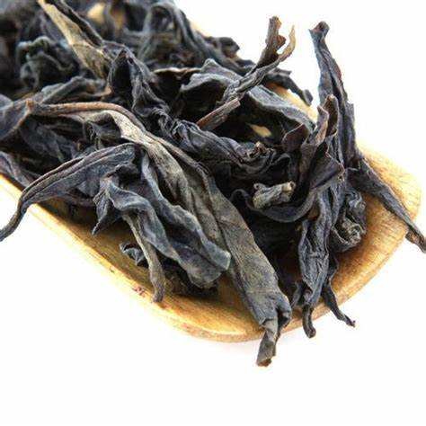
Rou Gui
Often translated as ‘cinnamon’, it is actually ‘cassia’ aka ‘Chinese cinnamon’
Rougui is the name of the tea cultivar and of the tea variety
Also known as Yu Gui
Discovered during the Qing Dynasty
It has become one of the most popular varietals in Wu Yi Shan today
Often sold as a blend or straight as Da Hong Pao or Tieluohan

