Slide 1
Bug Bitten Teas
Presented By:
New York Tea Society

Slide 2
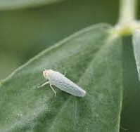
Bug Bitten Teas
Bug bitten teas are created by allowing small green leafhoppers, known as a tea jassid, to attack the tea plants prior to harvest.
When bitten by the jassid, the tea plants release specific volatile aromatic compounds which repel the bugs, but to the human palate are surprisingly reminiscent of honey.
The tea plants also release stored sugars and sends them to the bitten parts to promote recovery.
The effect of the leafhopper depends on
The cultivar
Different cultivars of tea plant respond differently to leafhoppers.
Longjing will defend itself against insects by producing more caffeine, which would lead to a more bitter tea
Qing Xin defends itself against insects by producing hotrienol, a chemical which attracts predators of the tea jassid, and is also responsible for the honey aroma we enjoy so much in bug bitten teas
The age of the leaves
Leaves of different ages react differently to insect damage.
Most green teas are produced with only one or two leaves and a bud while most oolongs are produced with older leaves.
The leafhopper produces undesirable chemical changes in young leaves and desirable changes in older leaves.
In green tea production, you’re only getting the bad changes, In oolong production, the good changes outweigh the bad ones.
The processing method.
The leafhopper causes the same chemical changes in all tea plants, but those chemicals get modified by different processing methods to create differences in the processed tea.
A leafhopper causes tea plants to produce compounds that when left unoxidized—as they would be in a green tea—produce undesirable flavors.
When the leaves are oxidized as in oolong processing, they become compounds with desirable characteristics in the finished tea

Slide 3
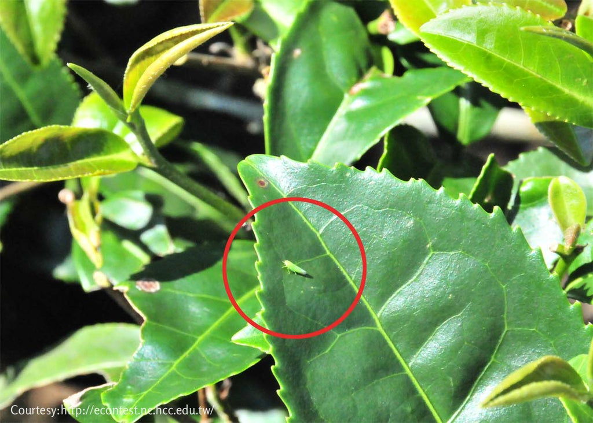
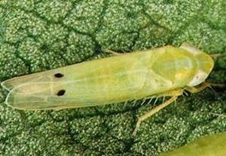
The Tea Jassid
Also known as a leafhopper
Scientifically known as
Jacobiasca Formosana in Taiwan
Empoasca Onukii in Japan
Empoasca Vitis in China
The mature tea jassid is slender and yellowish-green with translucent wings with a body length of about 3 mm
They leave almost unnoticeable bites on the tea leaves.
Skilled tea farmers with a trained eye will swiftly spot the difference.
Too many leafhoppers will damage the tea.
Too many bug bites will result in a bitter tea unworthy of sale.
To ensure a healthy tea garden, farmers must closely monitor the tea gardens and pluck the tea leaves as soon as they have sufficient bug bites.

Slide 4
Varieties of Bug-Bitten Teas
Dongfang Meiren
Gui Fei
Mi Xiang
Ye Sheng Chan Shan

Slide 5
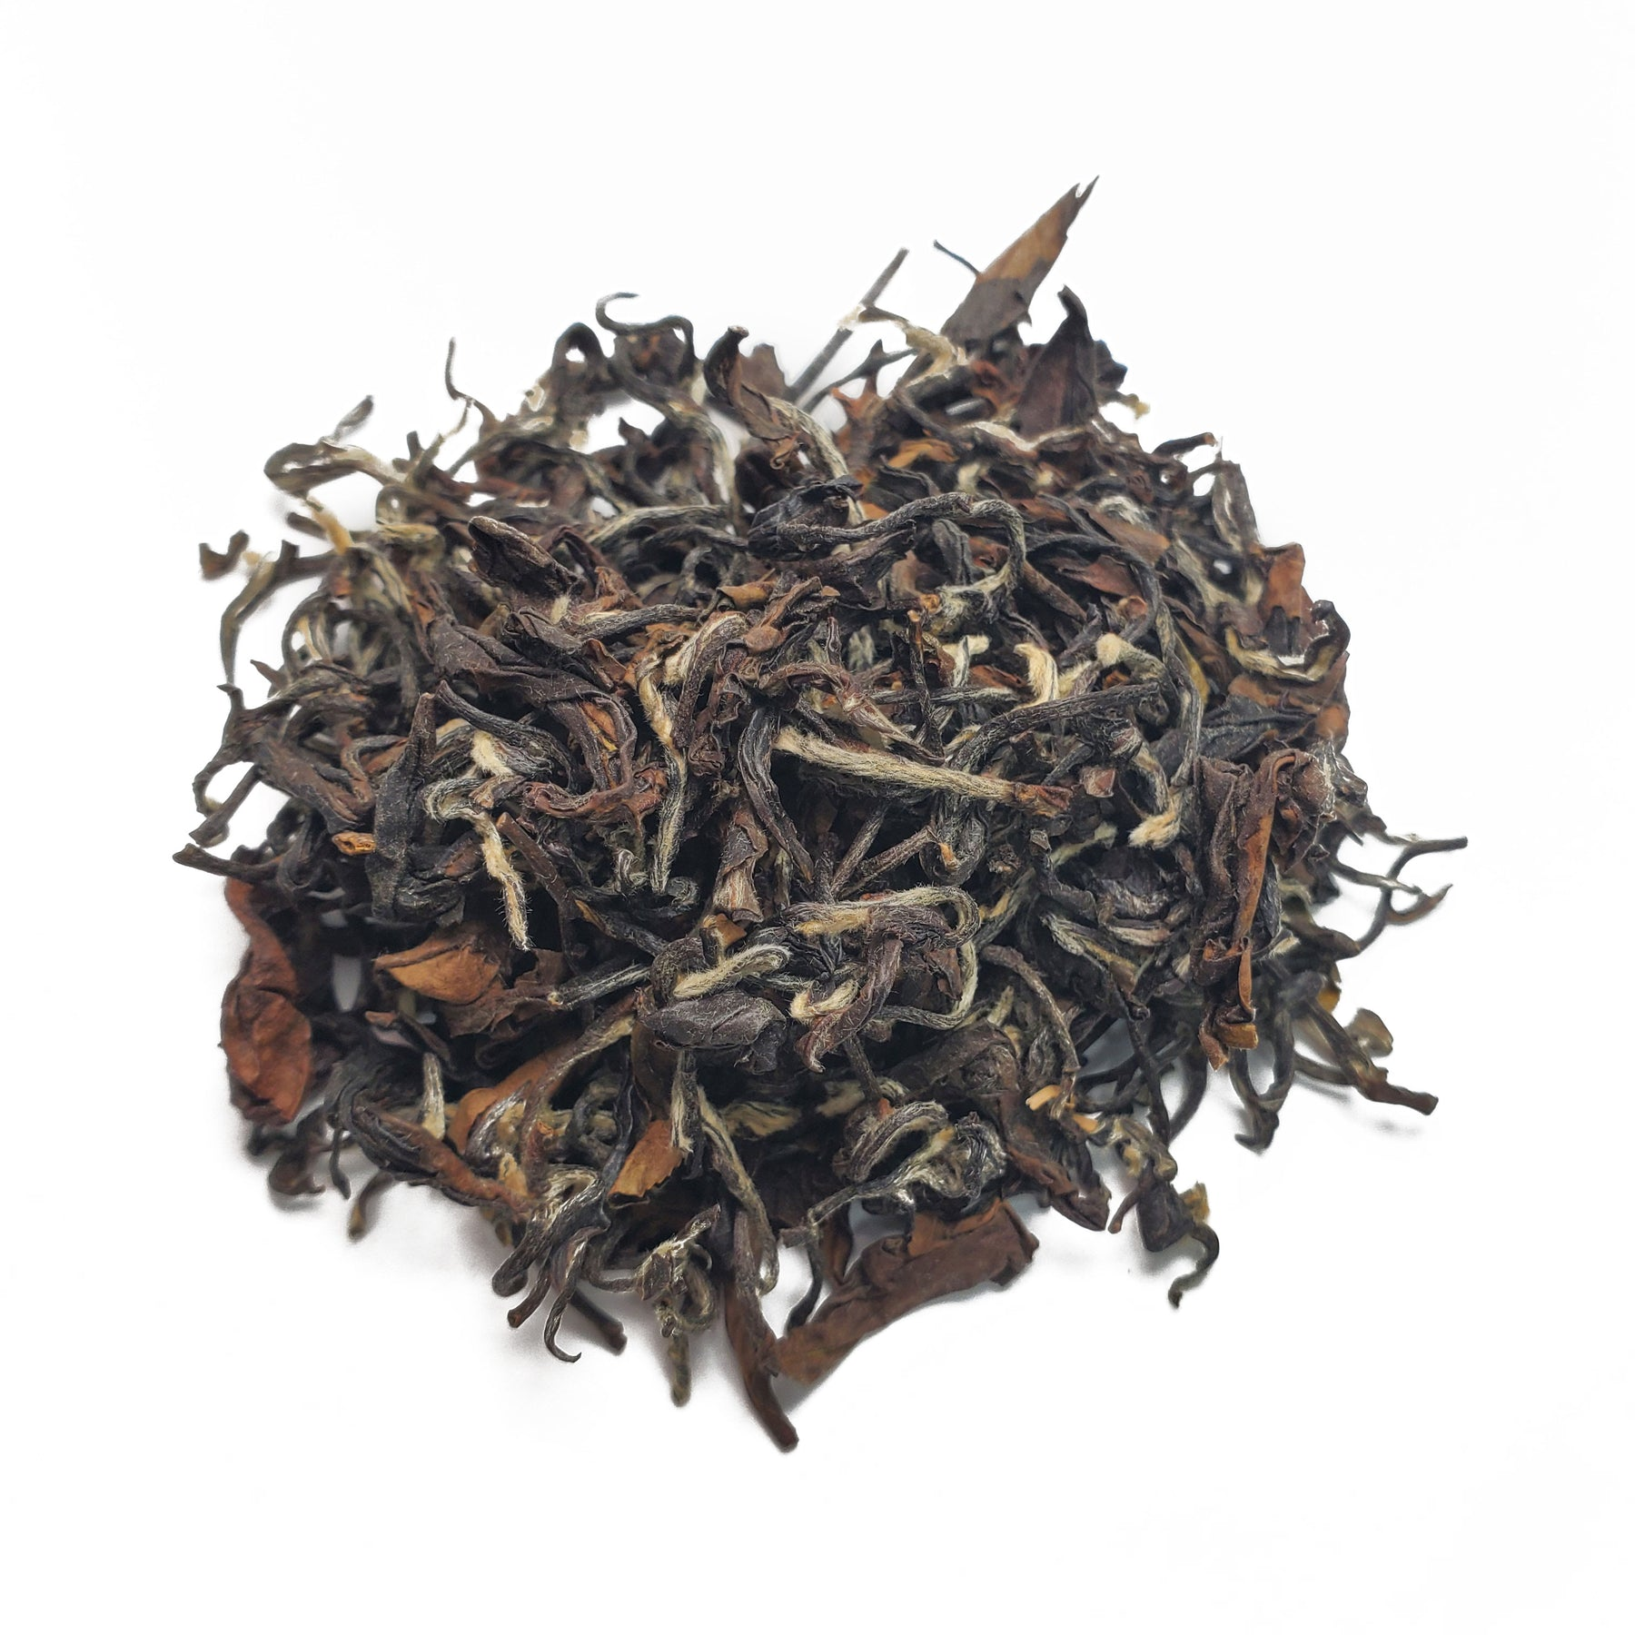
Dongfang Meiren
A highly oxidized (+/-70%) oolong harvested from young summer leaves, just after they have been bitten by the tea jassids.
Originated in the Hsinchu province of Taiwan
Created in 1932 by an unnamed tea farmer from Beipu
Tea farmers were upset because their crops were being eaten by small insects
They didn't harvest the bitten leaves, because this low-quality tea was usually turned down by the foreign tea traders.
The unnamed tea farmer harvested these bitten leaves
The farmer bragged to his friends about the high price he was able to sell this tea for after a local competition, and it was subsequently named "Peng Feng Cha" or bragger's tea by the locals.
The tea made its way to the queen of England who named it "Oriental Beauty"
The tea was exhibited at the 1935 Taipei International Exposition held by the Japanese colonial government to showcase Taiwan’s successes under Japanese rule.
Other names
Bai Hao Oolong - ‘White Hair Oolong’
Referring to the hairy fur on the dry leaves
Wu Se Cha - ‘5 Colors Tea’
Referring to the different colors in the dry leaves.

Slide 6
Gui Fei
A medium level oxidized oolong (+-40%)
In 1999 there was an earthquake in Nantou County in central Taiwan , causing the tea farmers of Fenghuang Village in Lugu Township to evacuate.
Upon returning the farmers noticed that the tea plants had been overrun with little insects that had nibbled on the leaves and stems.
They processed the least damaged leaves in the traditional dong ding method as they were accustomed.
They found that an almost magical transformation had occurred in the taste of the tea.
The tea liquor was crystal clear in orange color and full of honey aroma.
The brewed leaves were surrounded by red edges and looked very elegant and poised just like an ancient Gui Fei, the highest-ranking imperial concubine.
To this day same Fenghuang farmers in Taiwan encourage the little leaf-hoppers to nibble on the leaves to create this Gui Fei Oolong.
There is now a beautiful, mutually beneficial 4-way symbiotic relationship between the jassid, the tea plant, the farmer, and the tea drinker.

Slide 7
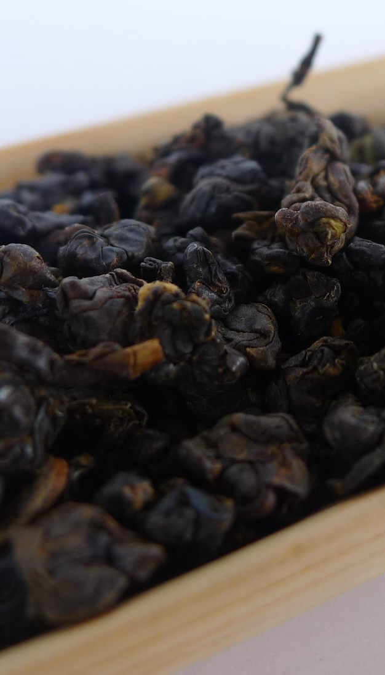
Mi Xiang
A fully oxidized Taiwanese tea
Mi Xiang translates to Honey Aroma
Mi Xiang is a term which often describes teas that have been bug-bitten due to the honey aroma and taste produced in the tea after being bitten by the tea jassids.
Mi Xiang can be found from different regions of Taiwan in both red tea and oolong varieties.

Slide 8
Ye Sheng Shan Cha
An insect-bitten style red tea
Harvested from an indigenous wild tea plant known to locals simply as Shan Cha (Mountain Tea).
Though these trees have been around for centuries, their discovery is ‘new’, and the tea trees have been renamed “Camellia Formosensis” after the island’s old name.
Its botanical characteristics are somewhat close to the Assamica plant with its long leaves
It prefers a wild, mountainous habitat with altitudes ranging between 1,000m to 1,500m.
Four distinct protected areas have been put in place in central, south and eastern Taiwan for the preservation of this National treasure which is revered as the father plant to some of the most unique and distinctive tea hybrids of Taiwan, such as Hong Yu (Red Jade).

